Slide 1
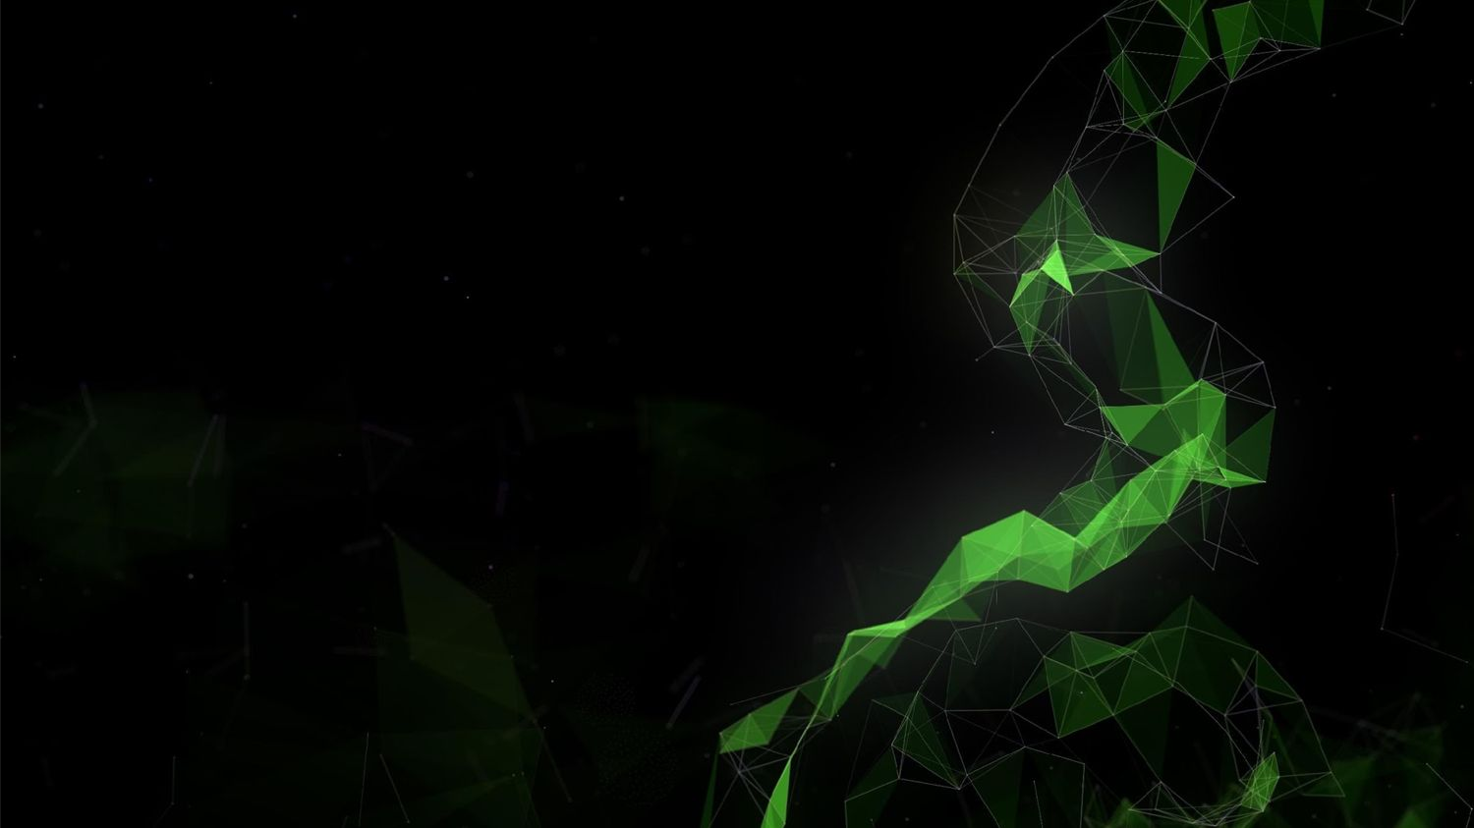
8-bit Inference with TensorRT
Szymon Migacz, NVIDIA
May 8, 2017

Slide 2
Intro
Goal: Convert FP32 CNNs into INT8 without significant accuracy loss.
Why: INT8 math has higher throughput, and lower memory requirements.
Challenge: INT8 has significantly lower precision and dynamic range than FP32.
Solution: Minimize loss of information when quantizing trained model weights to INT8 and during INT8 computation of activations.
Result: Method was implemented in TensorRT. It does not require any additional fine tuning or retraining.

Slide 3
Outline
INT8 compute
Quantization
Calibration
Workflow in TensorRT
Results

Slide 4
INT8 Inference
Challenge
INT8 has significantly lower precision and dynamic range compared to FP32.
 | Dynamic Range | Min Positive Value
FP32 | -3.4 x 10³⁸ ~ +3.4 x 10³⁸ | 1.4 x 10⁻⁴⁵
FP16 | -65504 ~ +65504 | 5.96 x 10⁻⁸
INT8 | -128 ~ +127 | 1
Requires more than a simple type conversion from FP32 to INT8.

Slide 5


High-throughput INT8 math
DP4A - INT8 dot product
Requires sm_61+ (Pascal TitanX, GTX 1080, Tesla P4, P40 and others).
Four-way byte dot product accumulated in 32-bit result.
A
int8 | int8 | int8 | int8
Result += A[0] * B[0] +
A[1] * B[1] +
A[2] * B[2] +
A[3] * B[3]
B
int8 | int8 | int8 | int8
int32

Slide 6
Context
Performance.
No accuracy loss.
Hence solution has to be “simple” and compute efficient.

Slide 7
Linear quantization
Representation:
Tensor Values = FP32 scale factor * int8 array + FP32 bias

Slide 8
Do we really need bias?
Two matrices:
A = scale_A * QA + bias_A B = scale_B * QB + bias_B
Let’s multiply those 2 matrices:
A * B = scale_A | * scale_B * QA | * QB | +
scale_A | * QA * bias_B |  | +
scale_B | * QB * bias_A |  | +
bias_A | * bias_B

Slide 9
Do we really need bias?
Two matrices:
A = scale_A * QA + bias_A B = scale_B * QB + bias_B
Let’s multiply those 2 matrices:
A * B = scale_A * scale_B * QA * QB +
scale_A * QA * bias_B scale_B * QB * bias_A bias_A * bias_B
+
+

Slide 10
Do we really need bias? No!
Two matrices:
A = scale_A * QA B = scale_B * QB
Let’s multiply those 2 matrices:
A * B = scale_A * scale_B * QA * QB

Slide 11
Symmetric linear quantization
Representation:
Tensor Values = FP32 scale factor * int8 array
One FP32 scale factor for the entire int8 tensor
Q: How do we set scale factor?

Slide 12
Quantization
No saturation: map |max| to 127
-|max|
0.0
+|max|
-127
0
127

Slide 13
Quantization
No saturation: map |max| to 127
-|max|
0.0
+|max|
-127
0
127
Significant accuracy loss, in general

Slide 14
Quantization
No saturation: map |max| to 127
Saturate above |threshold| to 127
-|T| 0.0 +|T|
-|max|
0.0
+|max|
-127
0
127
-127
0
127
Significant accuracy loss, in general

Slide 15
Quantization
No saturation: map |max| to 127
Saturate above |threshold| to 127
-|T| 0.0 +|T|
-|max|
0.0
+|max|
-127
0
127
-127
0
127
Significant accuracy loss, in general
Weights: no accuracy improvement
Activations: improved accuracy
Which |threshold| is optimal?

Slide 16
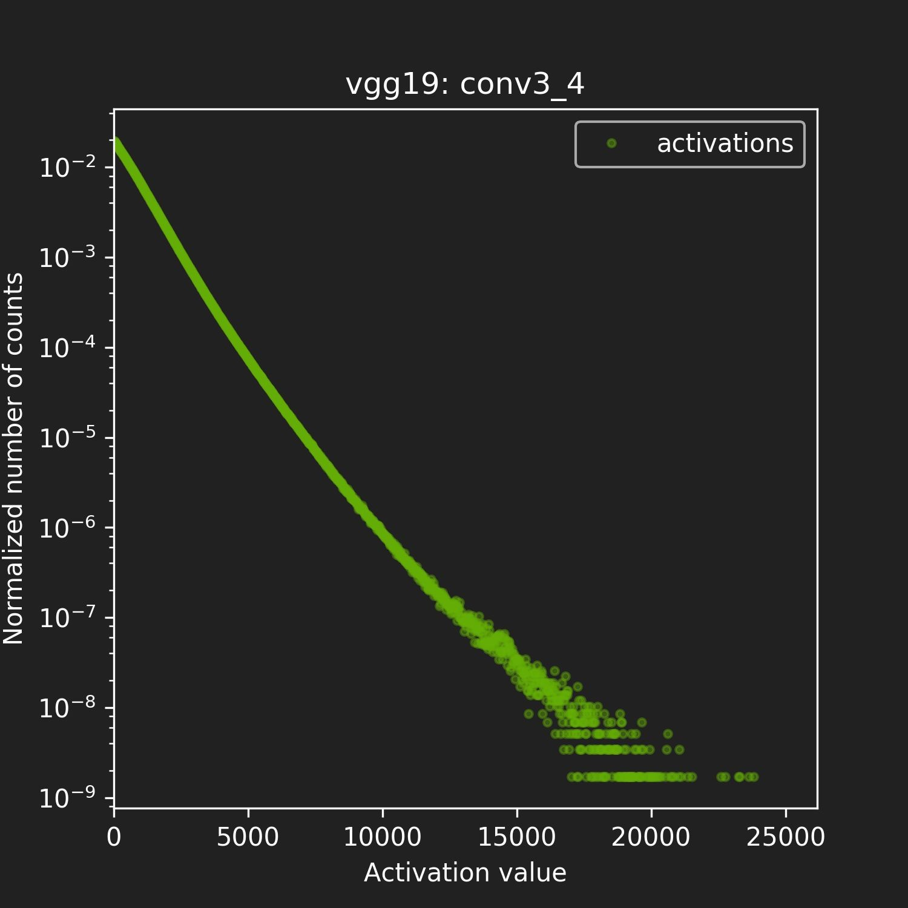
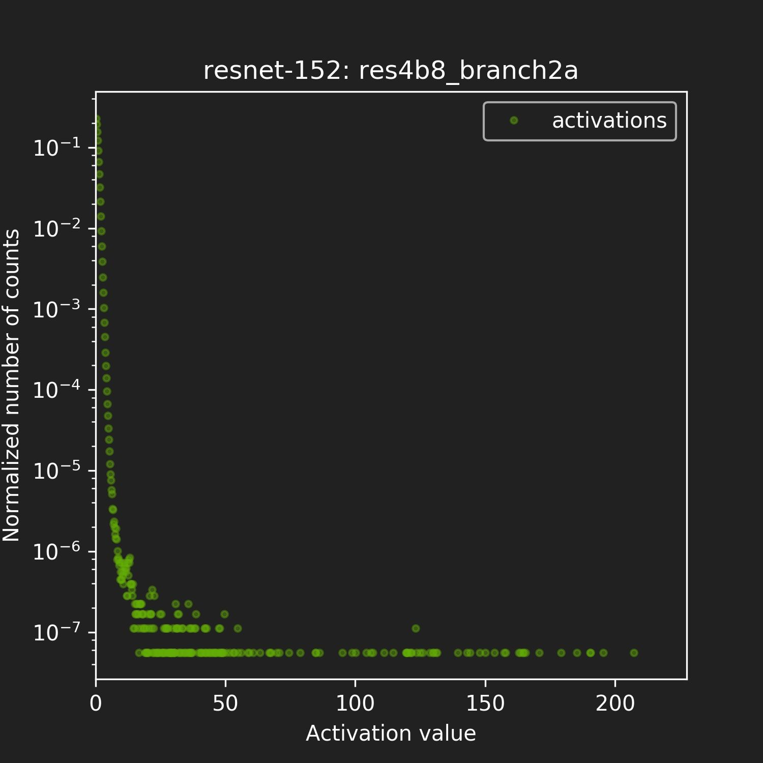
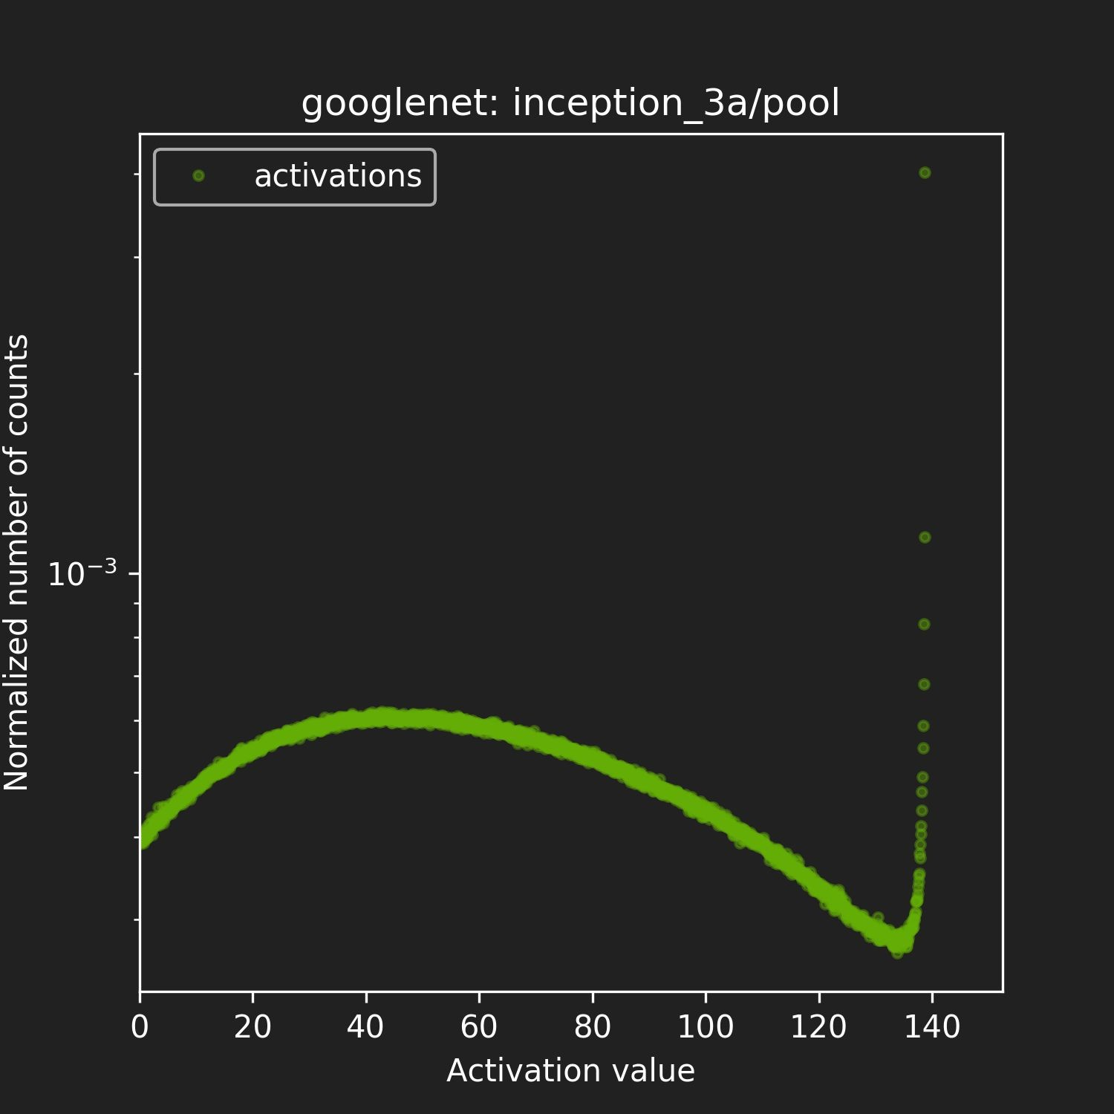
Q: How to optimize threshold selection?
It’s always a tradeoff between range and precision of the INT8 representation.
A: Minimize information loss, since FP32 → INT8 is just re-encoding information.

Slide 17
“Relative Entropy” of two encodings
INT8 model encodes the same information as the original FP32 model.
We want to minimize loss of information.
Loss of information is measured by Kullback-Leibler divergence (AKA
relative entropy or information divergence).
P, Q - two discrete probability distributions.
KL_divergence(P,Q):= SUM(P[i] * log(P[i] / Q[i] ), i)
Intuition: KL divergence measures the amount of information lost when approximating a given encoding.

Slide 18

Solution: Calibration
Run FP32 inference on Calibration Dataset.
For each Layer:
collect histograms of activations.
generate many quantized distributions with different saturation thresholds.
pick threshold which minimizes KL_divergence(ref_distr, quant_distr).
Entire process takes a few minutes on a typical desktop workstation.

Slide 19
Calibration Dataset
Representative.
Diverse.
Ideally a subset of validation dataset.
1000s of samples

Slide 20
Results from Calibration

Slide 21
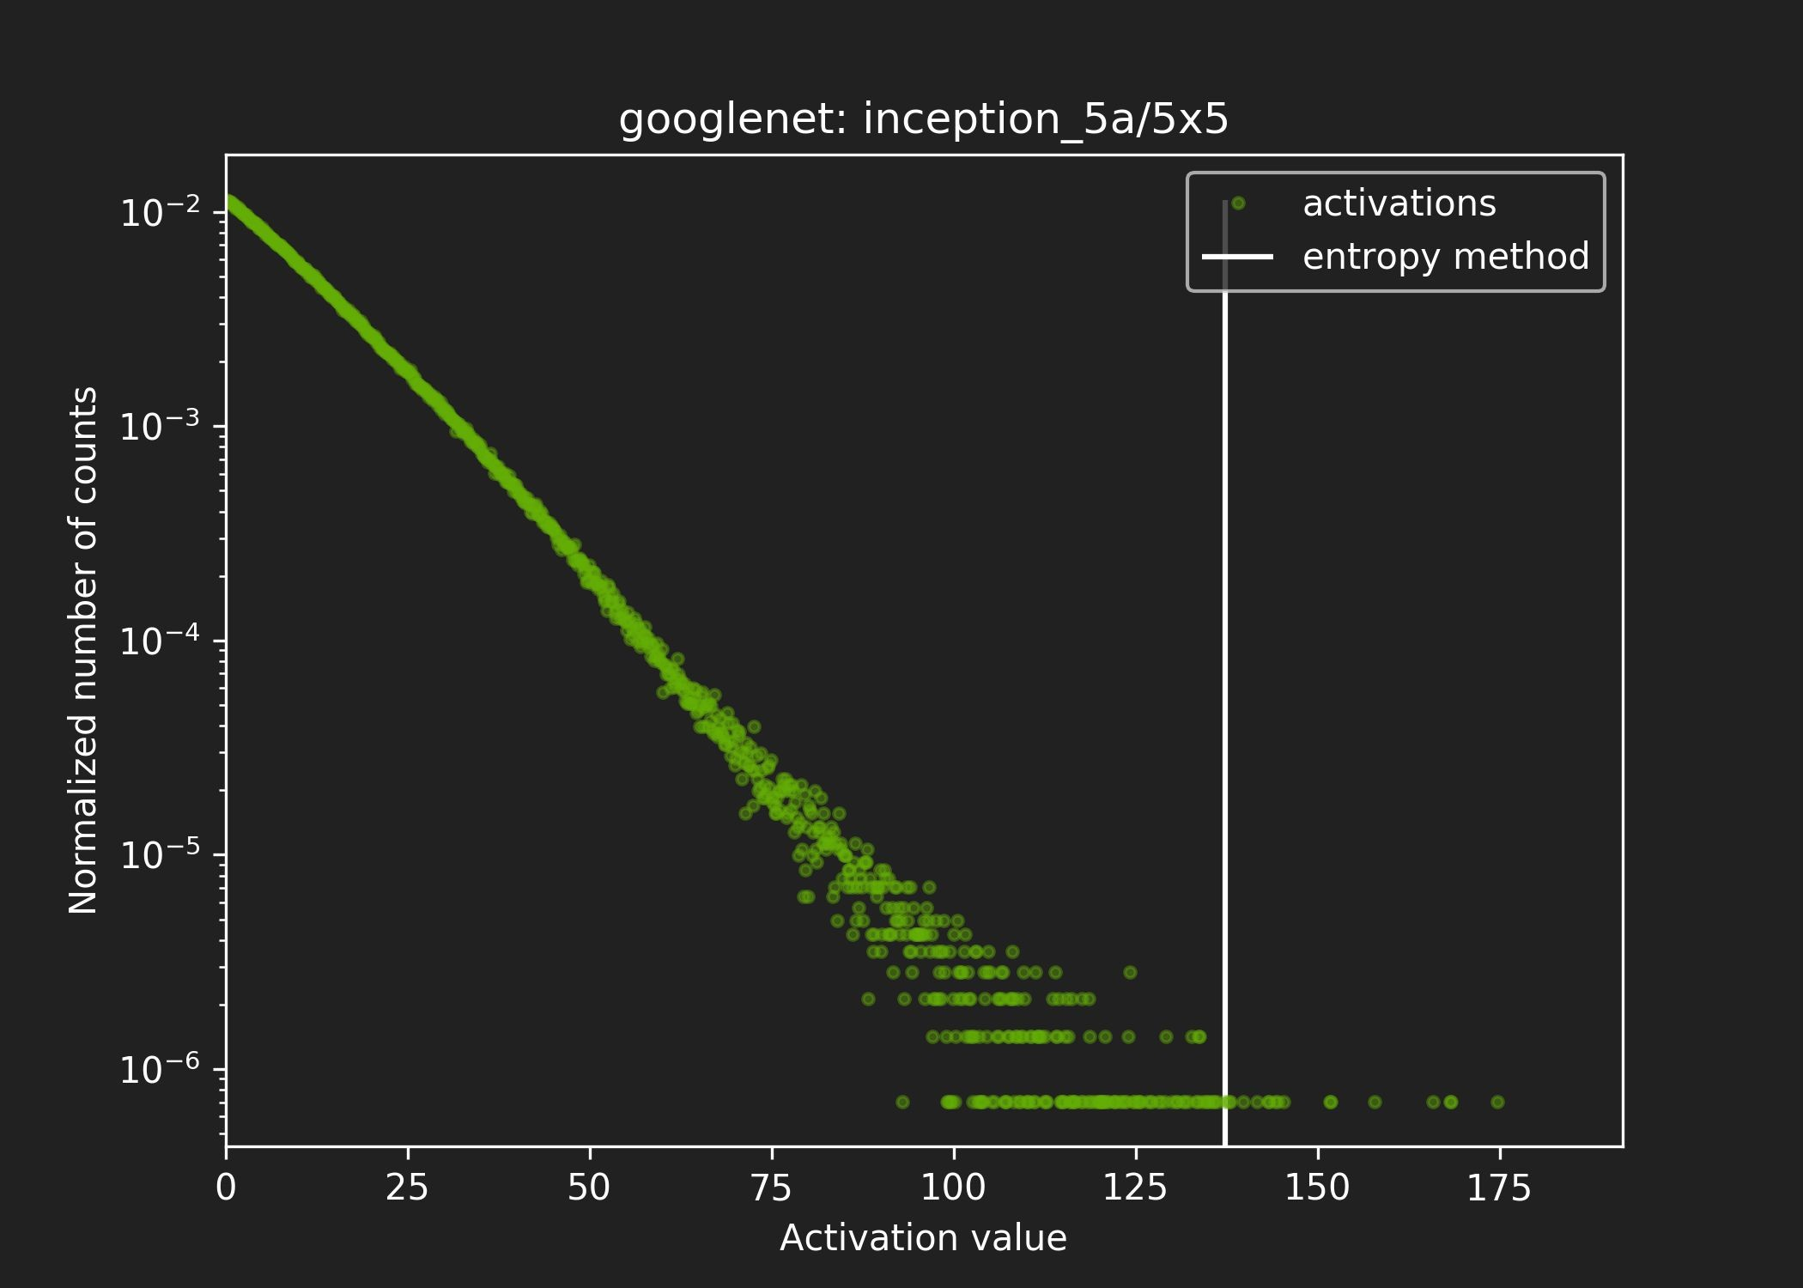
Results From Calibration #1

Slide 22
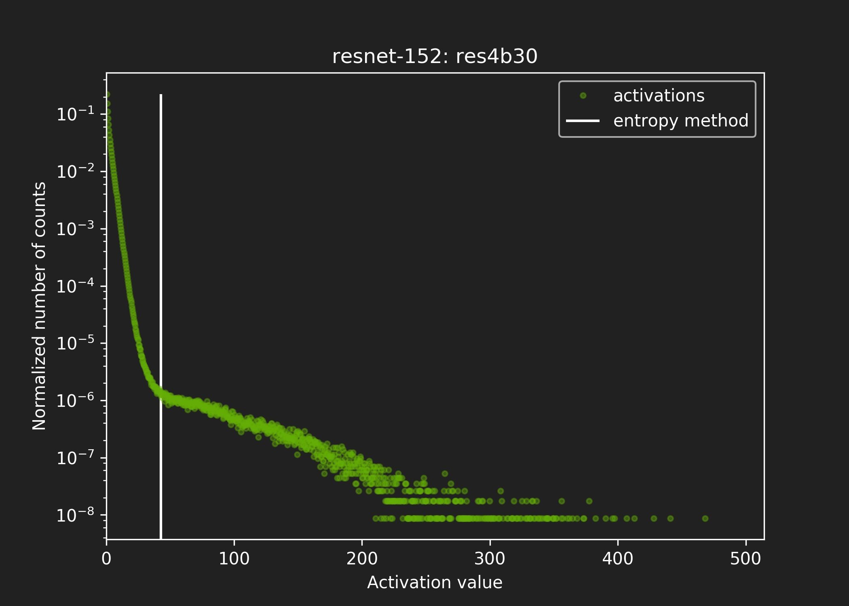
Results From Calibration #2

Slide 23
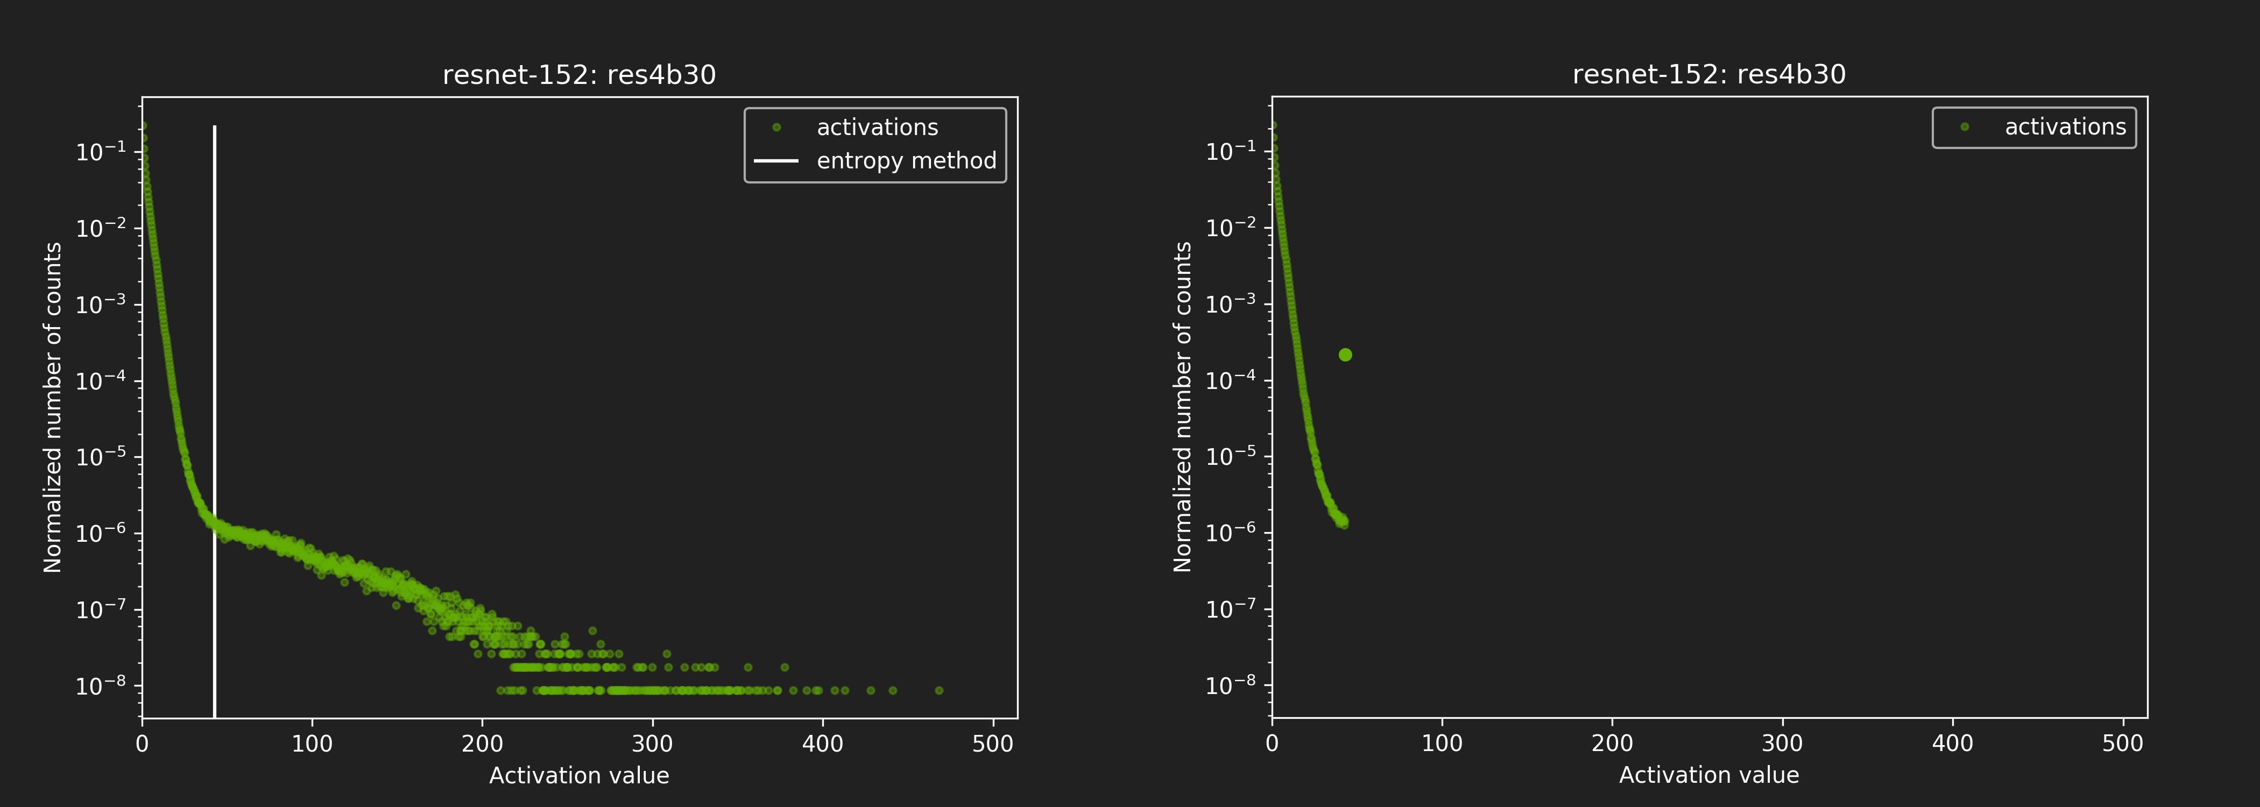

Results From Calibration #2
Before saturation After saturation

Slide 24
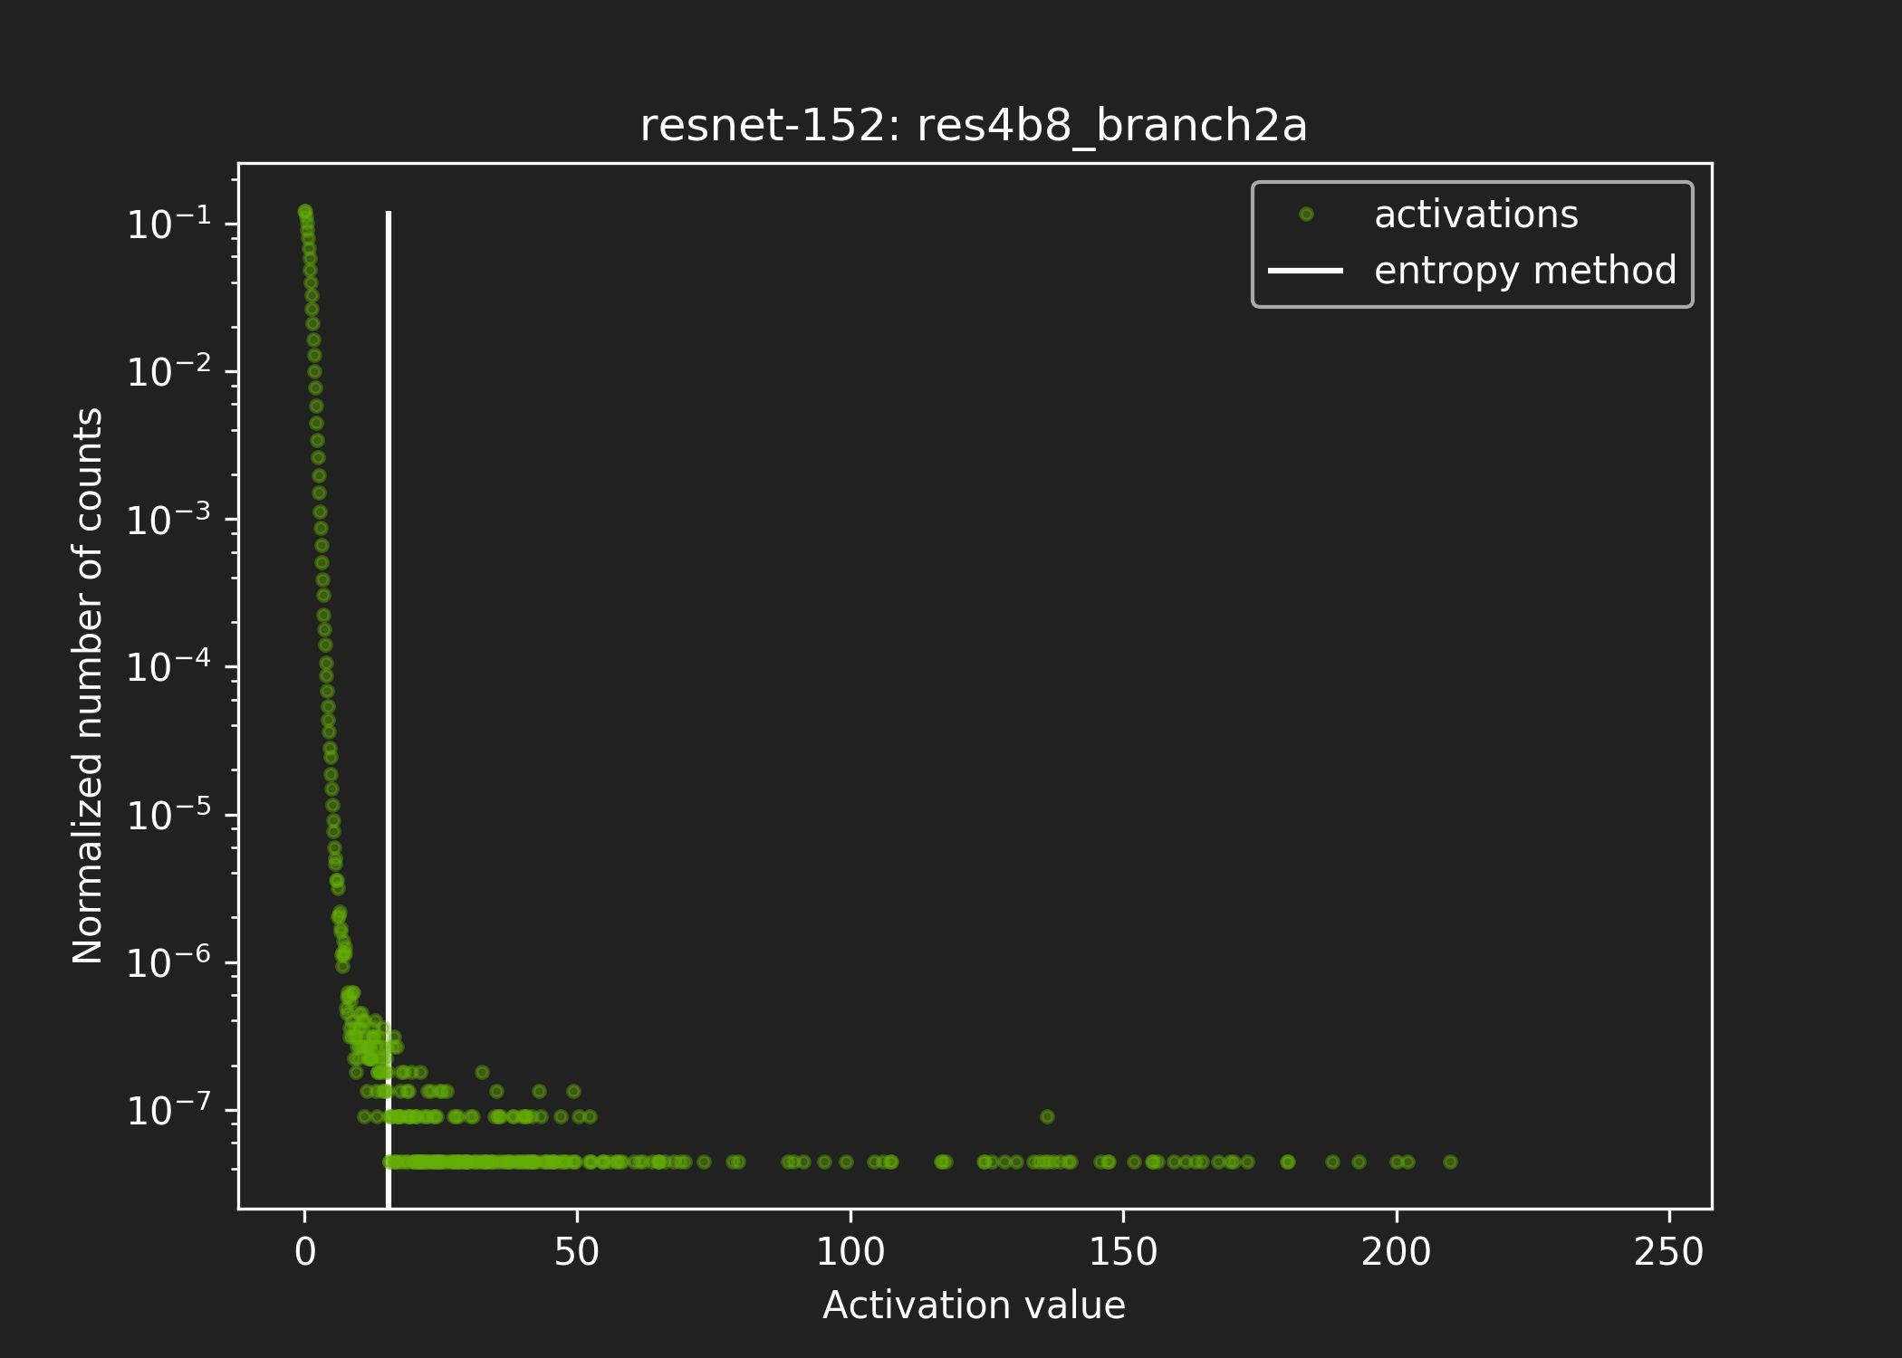
Results From Calibration #3

Slide 25
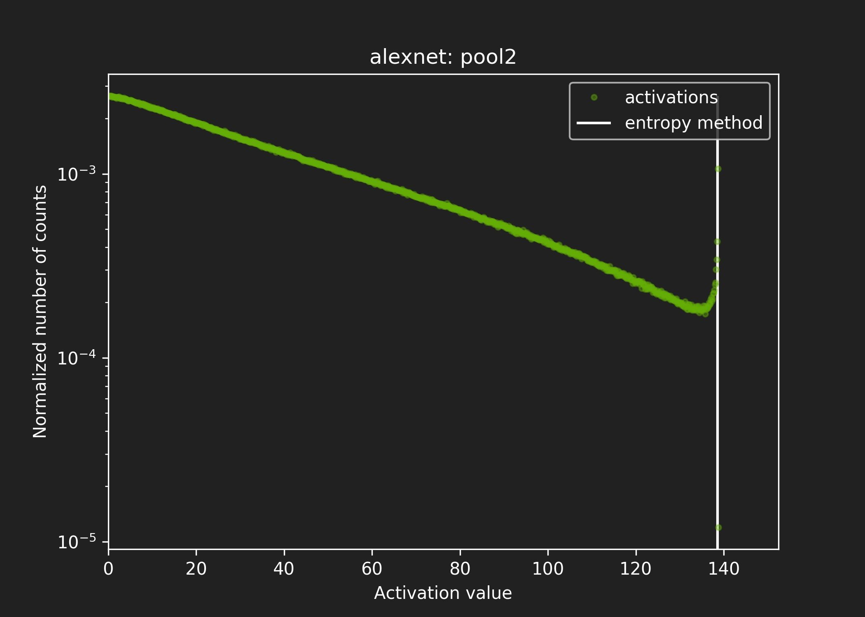
Results From Calibration #4

Slide 26
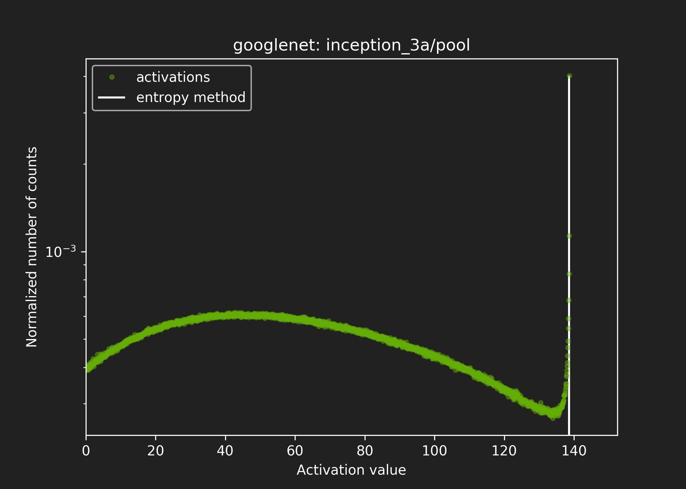
Results From Calibration #5

Slide 27
Workflow in TensorRT

Slide 28
Typical workflow in TensorRT
You will need:
Model trained in FP32.
Calibration dataset.
TensorRT will:
Run inference in FP32 on calibration dataset.
Collect required statistics.
Run calibration algorithm → optimal scaling factors.
Quantize FP32 weights → INT8.
Generate “CalibrationTable” and INT8 execution engine.

Slide 29
Results

Slide 30
Results - Accuracy
 | FP32 |  | INT8
 |  |  | Calibration using 5 batches |  | Calibration using 10 batches |  | Calibration using 50 batches
NETWORK | Top1 | Top5 | Top1 | Top5 | Top1 | Top5 | Top1 | Top5
Resnet-50 | 73.23% | 91.18% | 73.03% | 91.15% | 73.02% | 91.06% | 73.10% | 91.06%
Resnet-101 | 74.39% | 91.78% | 74.52% | 91.64% | 74.38% | 91.70% | 74.40% | 91.73%
Resnet-152 | 74.78% | 91.82% | 74.62% | 91.82% | 74.66% | 91.82% | 74.70% | 91.78%
VGG-19 | 68.41% | 88.78% | 68.42% | 88.69% | 68.42% | 88.67% | 68.38% | 88.70%
Googlenet | 68.57% | 88.83% | 68.21% | 88.67% | 68.10% | 88.58% | 68.12% | 88.64%
Alexnet | 57.08% | 80.06% | 57.00% | 79.98% | 57.00% | 79.98% | 57.05% | 80.06%
NETWORK | Top1 | Top5 | Diff Top1 | Diff Top5 | Diff Top1 | Diff Top5 | Diff Top1 | Diff Top5
Resnet-50 | 73.23% | 91.18% | 0.20% | 0.03% | 0.22% | 0.13% | 0.13% | 0.12%
Resnet-101 | 74.39% | 91.78% | -0.13% | 0.14% | 0.01% | 0.09% | -0.01% | 0.06%
Resnet-152 | 74.78% | 91.82% | 0.15% | 0.01% | 0.11% | 0.01% | 0.08% | 0.05%
VGG-19 | 68.41% | 88.78% | -0.02% | 0.09% | -0.01% | 0.10% | 0.03% | 0.07%
Googlenet | 68.57% | 88.83% | 0.36% | 0.16% | 0.46% | 0.25% | 0.45% | 0.19%
Alexnet | 57.08% | 80.06% | 0.08% | 0.08% | 0.08% | 0.07% | 0.03% | -0.01%
TensorRT 2.1, all optimizations enabled. ILSVRC2012 validation dataset, batch = 25 images. Accuracy was measured on 500 batches which were not used for the calibration.

Slide 31
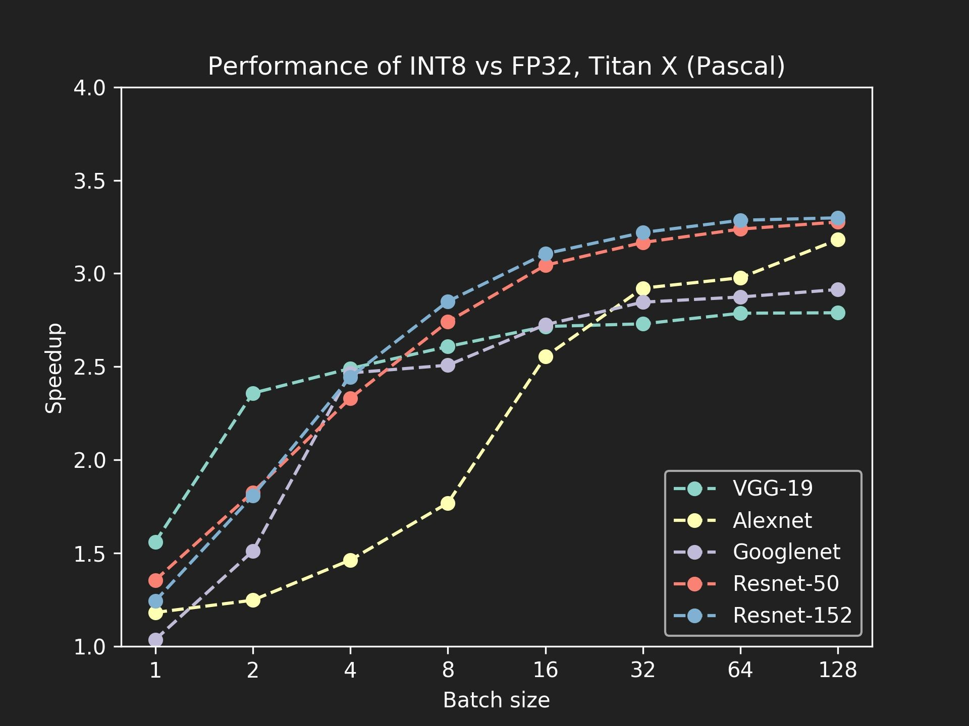
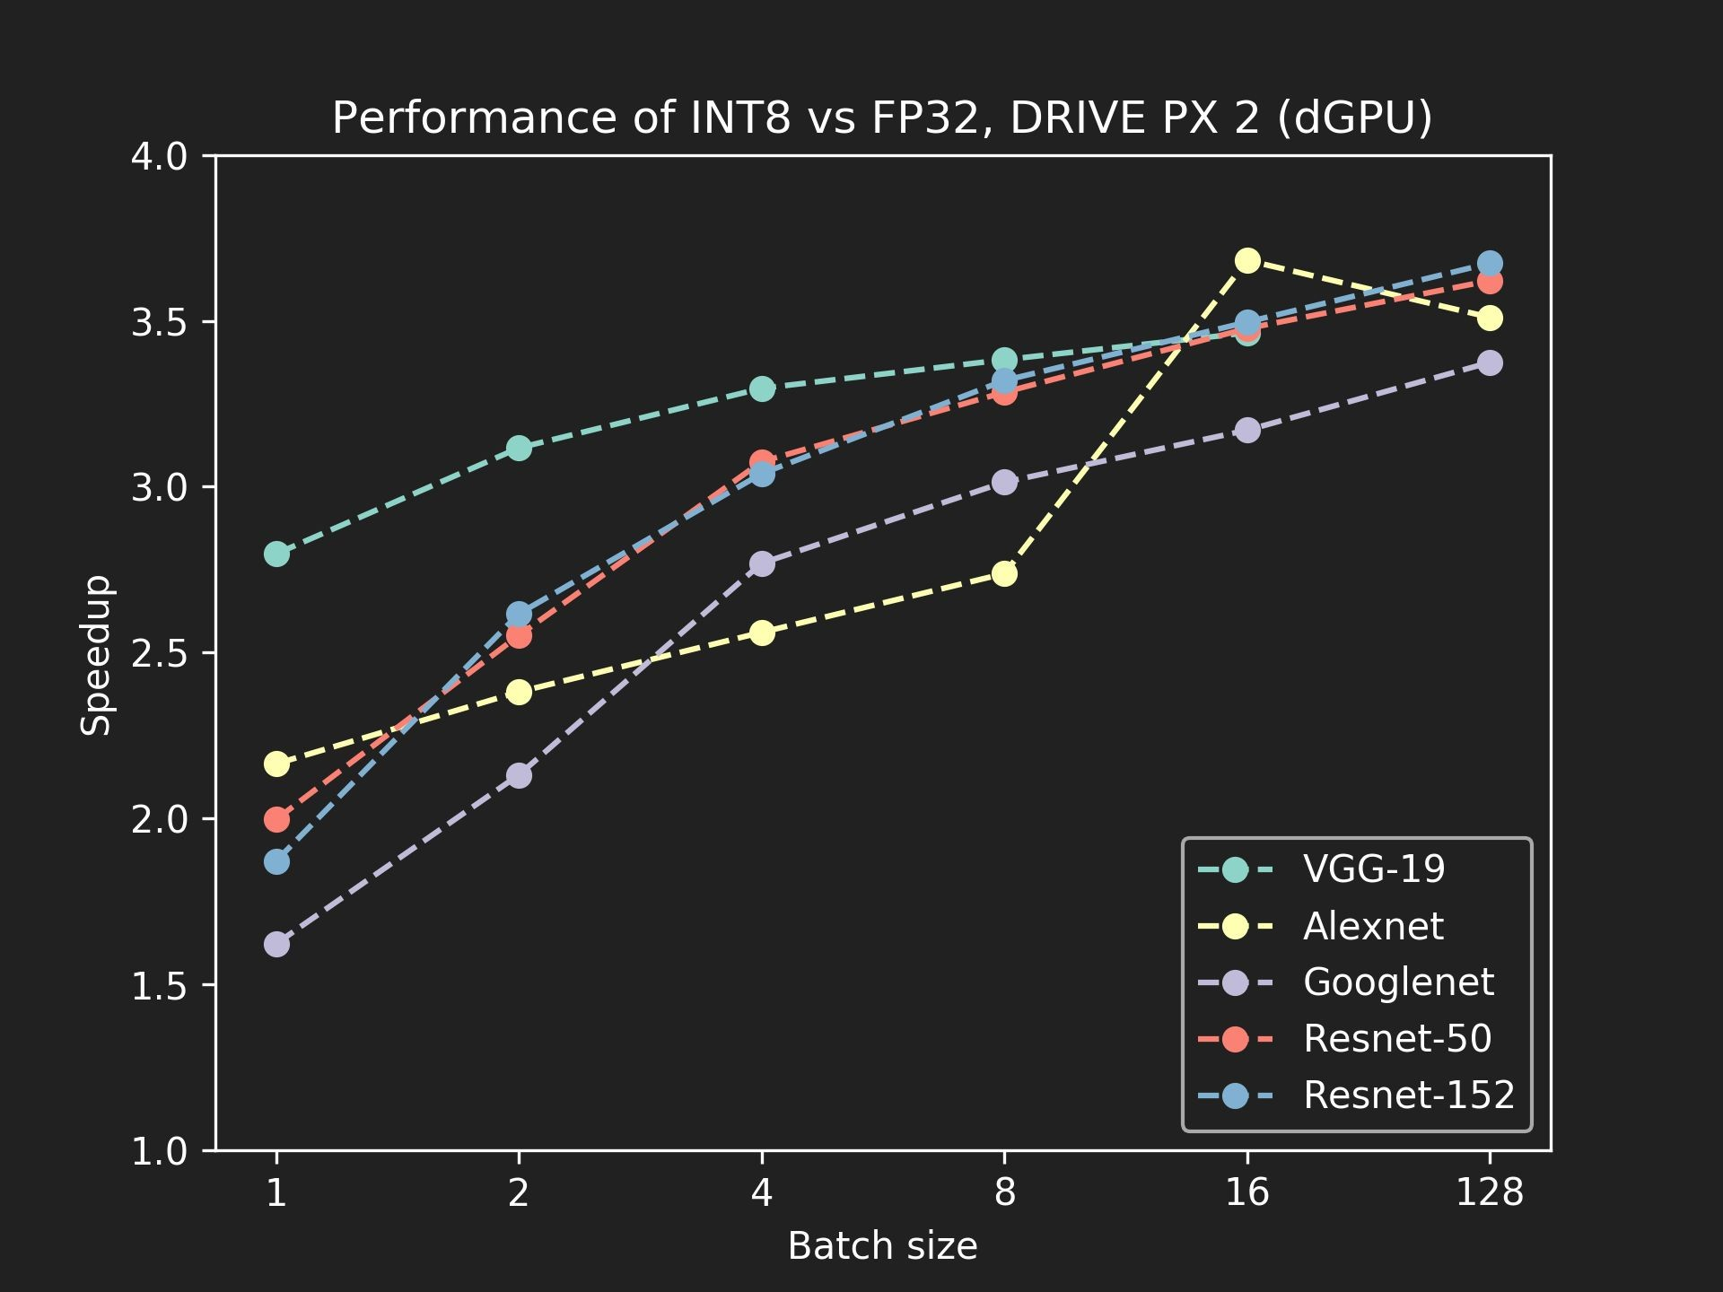
Results - Performance
TensorRT 2.1, all optimizations enabled.

Slide 32
Open challenges / improvements
Unsigned int8 for activations after ReLU.
RNNs → open research problem.
Fine tuning of saturation thresholds.
Expose API for accepting custom, user provided scale factors.

Slide 33
Conclusion
We introduced an automated, parameterless method for converting FP32
CNN models into INT8.
Symmetric, linear quantization for weights and activations.
Quantize original FP32 data such that the information loss is minimized.
Popular, publicly available CNN models trained in FP32 can be converted to INT8, accuracy of INT8 models is comparable with the FP32 baseline.

Slide 34
Additional Resources
We are going to publish whitepaper with description of the method.
TensorRT 2.1 is going to be released soon.
TensorRT 2.1 → sampleINT8.
S7458 - DEPLOYING UNIQUE DL NETWORKS AS MICRO-SERVICES WITH TENSORRT, USER EXTENSIBLE LAYERS, AND GPU REST ENGINE.
Tuesday, May 9, 4:30 PM - 4:55 PM.
Connect With The Experts:
Monday, May 8, 2:00 PM - 3:00 PM, Pod B.
Tuesday, May 9, 2:00 PM - 3:00 PM, Pod C.
Wednesday, May 10, 3:00 PM - 4:00 PM, Pod B.

Slide 35
Thank You

Slide 36
Backup slides

Slide 37
Entropy Calibration - pseudocode
Input: FP32 histogram H with 2048 bins: bin[ 0 ], …, bin[ 2047 ]
For i in range( 128 , 2048 ):
reference_distribution_P = [ bin[ 0 ] , ..., bin[ i-1 ] ] outliers_count = sum( bin[ i ] , bin[ i+1 ] , … , bin[ 2047 ] ) reference_distribution_P[ i-1 ] += outliers_count
P /= sum(P)
// take first ‘ i ‘ bins from H
// normalize distribution P
candidate_distribution_Q = quantize [ bin[ 0 ], …, bin[ i-1 ] ] into 128 levels // explained later
expand candidate_distribution_Q to ‘ i ’ bins Q /= sum(Q)
// explained later
// normalize distribution Q
divergence[ i ] = KL_divergence( reference_distribution_P, candidate_distribution_Q)
End For
Find index ‘m’ for which divergence[ m ] is minimal threshold = ( m + 0.5 ) * ( width of a bin )

Slide 38
Candidate distribution Q
KL_divergence(P, Q) requires that len(P) == len(Q)
Candidate distribution Q is generated after merging ‘ i ’ bins from bin[0] to bin[i-1] into 128 bins
Afterwards Q has to be ‘expanded’ again into ‘i’ bins
Here is a simple example: reference distribution P consisting of 8 bins, we want to quantize into 2 bins: P = [ 1, 0, 2, 3, 5, 3, 1, 7]
we merge into 2 bins (8 / 2 = 4 consecutive bins are merged into one bin) [1 + 0 + 2 + 3 , 5 + 3 + 1 + 7] = [6, 16]
then proportionally expand back to 8 bins, we preserve empty bins from the original distribution P: Q = [ 6/3, 0, 6/3, 6/3, 16/4, 16/4, 16/4, 16/4] = [ 2, 0, 2, 2, 4, 4, 4, 4]
now we should normalize both distributions, after that we can compute KL_divergence P /= sum(P) Q /= sum(Q)
result = KL_divergence(P, Q)

Slide 39
Pseudocode for the INT8 conv kernel
// I8 input tensors: I8_input, I8_weights, I8 output tensors: I8_output
// F32 bias (original bias from the F32 model)
// F32 scaling factors: input_scale, output_scale, weights_scale[K]
I32_gemm_out = I8_input * I8_weights // Compute INT8 GEMM (DP4A) F32_gemm_out = (float)I32_gemm_out // Cast I32 GEMM output to F32 float
// At this point we have F32_gemm_out which is scaled by ( input_scale * weights_scale[K] ),
// but to store the final result in int8 we need to have scale equal to "output_scale", so we have to rescale:
// (this multiplication is done in F32, *_gemm_out arrays are in NCHW format) For i in 0, ... K-1:
rescaled_F32_gemm_out[ :, i, :, :] = F32_gemm_out[ :, i, :, :] * [ output_scale / (input_scale * weights_scale[ i ] ) ]
// Add bias, to perform addition we have to rescale original F32 bias so that it's scaled with "output_scale" rescaled_F32_gemm_out _with_bias = rescaled_F32_gemm_out + output_scale * bias
// Perform ReLU (in F32)
F32_result = ReLU(rescaled_F32_gemm_out _with_bias)
// Convert to INT8 and save to global
I8_output = Saturate( Round_to_nearest_integer( F32_result ) )

Slide 40
Results - Performance - Pascal Titan X
 | batchsize = 1 |  |  | batchsize = 2 |  |  | batchsize = 8 |  |  | batchsize = 32 |  |  | batchsize = 128
Network | INT8 [img/s] | FP32 [img/s] | Ratio | INT8 [img/s] | FP32 [img/s] | Ratio | INT8 [img/s] | FP32 [img/s] | Ratio | INT8 [img/s] | FP32 [img/s] | Ratio | INT8 [img/s] | FP32 [img/s] | Ratio
Resnet-50 | 562 | 415 | 1.354 | 1045 | 572 | 1.825 | 2572 | 938 | 2.741 | 3567 | 1126 | 3.166 | 3787 | 1156 | 3.276
Resnet-152 | 195 | 157 | 1.242 | 371 | 205 | 1.807 | 1017 | 357 | 2.850 | 1335 | 415 | 3.220 | 1437 | 436 | 3.299
VGG-16 | 393 | 261 | 1.508 | 606 | 257 | 2.361 | 984 | 382 | 2.577 | 1131 | 416 | 2.722 | 1178 | 426 | 2.764
VGG-19 | 345 | 221 | 1.559 | 523 | 222 | 2.358 | 812 | 311 | 2.608 | 916 | 336 | 2.729 | 946 | 339 | 2.789
Googlenet | 945 | 913 | 1.035 | 1756 | 1163 | 1.510 | 4356 | 1737 | 2.508 | 6545 | 2300 | 2.846 | 7282 | 2499 | 2.914
Alexnet | 972 | 823 | 1.181 | 1913 | 1534 | 1.247 | 6434 | 3638 | 1.768 | 13899 | 4758 | 2.921 | 18714 | 5882 | 3.181
TensorRT FP32 vs TensorRT INT8 Pascal TitanX

Slide 41
Results - Performance - DRIVE PX 2, dGPU
 | batchsize = 1 |  |  | batchsize = 2 |  |  | batchsize = 4 |  |  | batchsize = 16 |  |  | batchsize = 128
Network | INT8 [img/s] | FP32 [img/s] | Ratio | INT8 [img/s] | FP32 [img/s] | Ratio | INT8 [img/s] | FP32 [img/s] | Ratio | INT8 [img/s] | FP32 [img/s] | Ratio | INT8 [img/s] | FP32 [img/s] | Ratio
Resnet-50 | 295 | 148 | 1.996 | 462 | 181 | 2.552 | 627 | 204 | 3.075 | 811 | 233 | 3.477 | 902 | 249 | 3.621
Resnet-152 | 110 | 59 | 1.871 | 179 | 68 | 2.617 | 239 | 79 | 3.039 | 318 | 91 | 3.496 | 356 | 97 | 3.674
VGG-16 | 130 | 47 | 2.757 | 189 | 62 | 3.029 | 229 | 71 | 3.220 | 286 | 84 | 3.411 | DNR | DNR
VGG-19 | 114 | 41 | 2.797 | 162 | 52 | 3.117 | 191 | 58 | 3.296 | 233 | 67 | 3.464 | DNR | DNR
Googlenet | 497 | 306 | 1.622 | 777 | 364 | 2.131 | 1131 | 408 | 2.769 | 1576 | 497 | 3.170 | 1784 | 529 | 3.375
Alexnet | 436 | 202 | 2.164 | 828 | 348 | 2.381 | 1458 | 570 | 2.561 | 3106 | 844 | 3.682 | 4853 | 1382 | 3.510
TensorRT FP32 vs TensorRT INT8 DRIVE PX 2, dGPU

